Slide 1

PROJECT PRESENTATION
PRESENTED BY SUNIL NAIK

Slide 2
UBER TRIP ANALYSIS
UNCOVERING TRAVEL TRENDS IN NYC USING DATA SCIENCE
KHETHAVATH SUNIL NAIK
IIT BHILAI

Slide 3

Origin of the creative idea
Inspiration from Real-World Mobility Challenges
Rapid urbanization and the surge in ride-sharing services like Uber prompted the need for better urban mobility understanding.
Problem Framing
Instead of just analyzing data, the goal was to uncover why, when, and how ride demand fluctuates—leading to a predictive analytics approach.
Exploring creativity

Slide 4





Executive Summary
Objective: Analyze 6 months of Uber trip data in NYC.
Methods: Data cleaning, feature extraction, visualization, and machine learning.
Key Findings: Evening peak hours, Friday busiest, growth from April to Sept.
Outcome: Insightful visual patterns and predictive modeling for demand estimation.

Slide 5
With the rise of ride-sharing platforms like Uber, large-scale transportation data became publicly accessible. This project leverages six months of Uber pickup data in New York City to uncover patterns in urban mobility using data science techniques, enabling smarter planning and predictive insights.
INTRODUCTION
The aim of this project is to analyze Uber trip data to understand temporal and spatial patterns in ride demand, visualize peak usage trends, and build predictive models to forecast future trip volumes, aiding in operational decision-making and resource optimization.
BACKGROUND
Rise of ride-sharing data, opportunity for operational insights.
AIM
Understand hourly/weekly patterns and identify busy zones.
USE CASES
City planning, surge pricing, driver deployment.
Insights from this analysis can help ride-sharing companies optimize driver allocation, implement dynamic pricing strategies, and improve customer experience. Urban planners can also use these patterns to enhance public transportation and reduce congestion in high-demand zones.
Exploring creativity

Slide 6
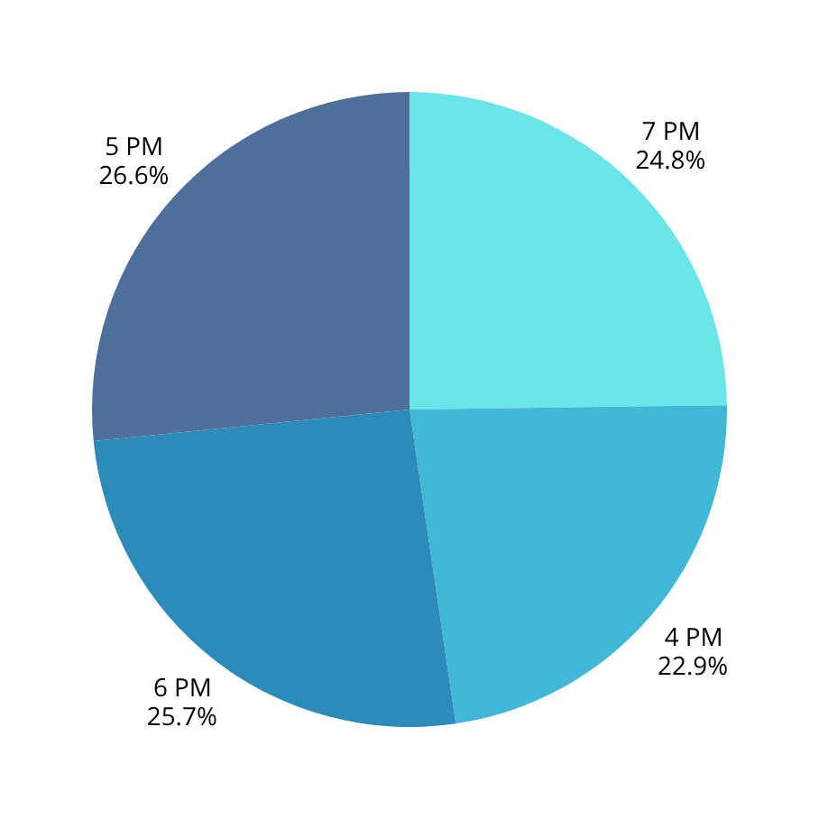
Most Active Trip Hours
320k
298k
5 PM
7 PM
Rides peak at 5 PM due to the evening rush hour when most people leave work. This time marks a high demand for commuting, especially in business hubs like Manhattan.
Rides peak at 7 PM due to people heading out for dinner, social events, or returning home after extended work hours. It's a prime time for evening leisure and post-commute travel in urban areas like NYC.
310k
275k
6 PM
4 PM
Rides peak at 6 PM due to the evening rush hour when most people leave work. It's also a popular time for heading to social events, restaurants, or commuting home.
Rides peak at 4 PM as people begin leaving work or heading to after-school activities. It marks the start of the evening rush, especially in business-heavy areas like Manhattan.

Slide 7


Creation process
Data Pre-processing
Feature Engineering
Combined monthly data files
Converted string to datetime objects
Extracted hour, day, weekday, month
Verified data quality (no nulls, consistent types)
Extracted: Hour, Day, Month, Weekday, Date
Aggregated: Trips per Base, Month, Weekday
Flags: Weekend, Rush Hour
Spatial Tags (future work): GPS-based clustering zones
Exploratory Data Analysis
Modeling
Trips per Hour: Peak: 5 PM - 8 PM; Drop: 3 AM - 6 AM
Trips per Weekday: Friday & Saturday busiest
Trips per Month: Steady rise; September peak
Objective: Predict hourly/daily trip counts
Models:
Random Forest Regressor
Gradient Boosting Regressor
XGBoost Regressor
Metrics: MAE, RMSE, R²

Slide 8
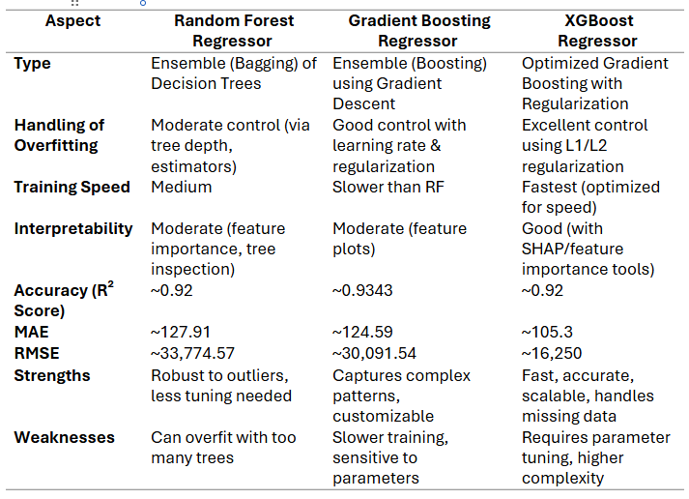
RESULTS

Slide 9

CONCLUSION
Uncovered key travel patterns like peak hours, busiest days, and base performance using EDA.
Built accurate prediction models — XGBoost and Stacking Regressor delivered the best results.
Engineered time-based features that enabled trend discovery and modeling.
Demonstrated how data science can support smarter urban mobility and operational planning.

Slide 10
Thank you very much!
PRESENTED BY SUNIL NAIK

